Slide 1
Error Handling
Lecturer: Ngo Huy Bien
Software Engineering Department
Faculty of Information Technology
VNUHCM - University of Science
Ho Chi Minh City, Vietnam
nhbien@fit.hcmus.edu.vn

Slide 2

Objectives
To handle errors
To use exceptions
To use transactions

Slide 3

Contents

Slide 4

References
Steve McConnell, Code Complete, Second Edition. 2004.
https://today.java.net/article/2006/04/04/exception-handling-antipatterns
http://c2.com/cgi/wiki?DontUseExceptionsForFlowControl
http://c2.com/cgi/wiki?PrincipleOfLeastAstonishment
Logging In C++ http://www.drdobbs.com/cpp/logging-in-c/201804215?pgno=1
Introducing System.Transactions in the .NET Framework 2.0 http://msdn.microsoft.com/en-us/library/ms973865.aspx
Roger Barga et al. Recovery Guarantees for Internet Applications. 2004.
Dino Esposito and Andrea Saltarello. Microsoft .NET - Architecting Applications for the Enterprise, Second Edition. 2014.

Slide 5
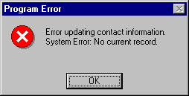
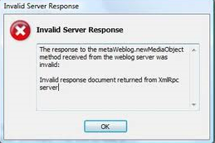
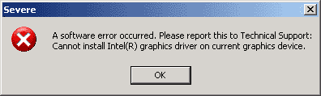
Error Sources [1]
Unexpected or malformed user input
Failure of one or more hardware components
Network errors or maintenance
Third party services problem

Slide 6

Error-Handling
Error handling is code that's used to handle errors that you do expect to occur.
Return a neutral value
Return an error code
Log a warning message to a file
Display an error message wherever the error is encountered
Shut down
Robustness vs. Correctness

Slide 7
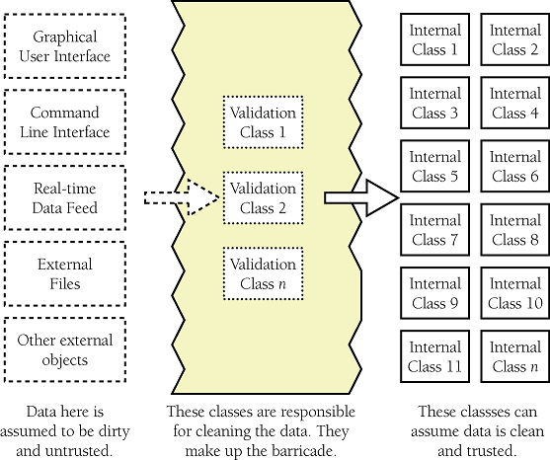
Barricades
Barricades are a damage-containment strategy.
Designate certain interfaces as boundaries to "safe" areas. Check data crossing the boundaries of a safe area for validity, and respond sensibly if the data isn't valid.

Slide 8
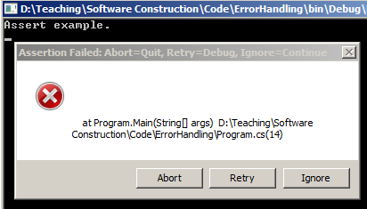
Assertions
An assertion is code that's used during development—usually a routine or macro—that allows a program to check itself as it runs. When an assertion is true, that means everything is operating as expected. When it's false, that means it has detected an unexpected error in the code.
Assertions are used to handle errors that should never occur in the code.

Slide 9
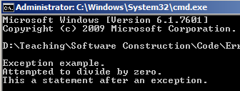
Exceptions
Exceptions are a specific means by which code can pass along errors or exceptional events to the code that called it.

Slide 10
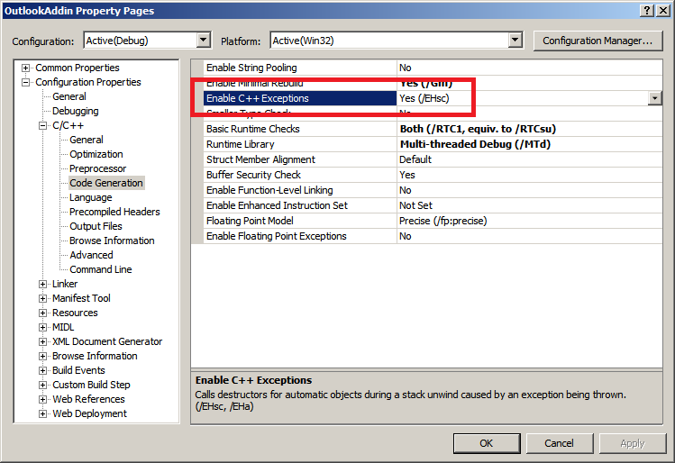
C++ Exception Handling Model

Slide 11
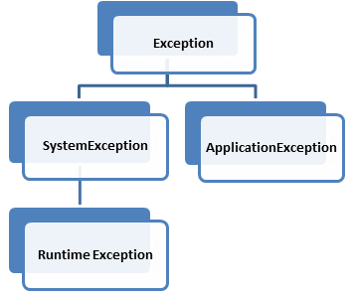
Exception Types [2]
Checked exceptions are exceptions indicating an expected problem that can occur during normal system operation.
Unchecked exceptions are exceptions indicating an unexpected problem that is probably due to a bug in the code (NullPointerException, IllegalAccessException...).
Errors are serious problems that are almost certainly not recoverable (OutOfMemoryError, StackOverflowError...)

Slide 12
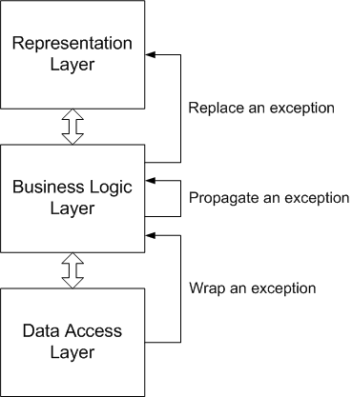
Where to Catch Exception?
catch(DataException e)
{ //Provide extra information
LogicException exception =
new LogicException("Unable to access the configured data source");
throw exception;
}
catch(DataException e)
{
//Do something
throw;
}
catch(SQLException e) //Preserve encapsulation { DataException exception = new DataException(e); throw exception; }

Slide 13

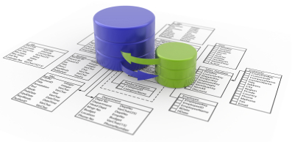
When to use Exceptions?
Exceptions due to programming errors (null, invalid arguments)
Exceptions due to client code errors (invalid API input)
Exceptions due to resource failures (network, file, database...)
Opening files
Reading files
Saving files
Deleting files
Connecting to database
Reading from database
Saving to database
Deleting from database

Slide 14
Log and Throw Anti-Pattern [2]
catch (NoSuchMethodException e) { LOG.error("Blah", e); throw e; }
catch (NoSuchMethodException e) { LOG.error("Blah", e); throw new MyServiceException("Blah", e); }
Either log the exception, or throw it, but never do both.
Logging and throwing results in multiple log messages for a single problem in the code.

Slide 15
Catching Exception Anti-Pattern
try {
foo();
} catch (Exception e) {
LOG.error("Foo failed", e);
}
Catch the specific exceptions that can be thrown.
If the method you are calling later adds a new checked exception to its method signature, the developer's intent is that you should handle the specific new exception.

Slide 16
Null or Exceptions?
User getUser(Guid userId)
{
if (!this.UserExists(userId)
throw new ApplicationException(“User does not exist.”);
// return null;
User user = null;
//Do something else
return user;
}

Slide 17
Principle Of Least Astonishment [4]
The Principle of Least Astonishment states that the result of performing some operation should be obvious, consistent, and predictable, based upon the name of the operation and other clues.
Bad:
int multiply(int a, int b)
{ return a + b; }
Better:
int multiply(int a, int b)
{ return a * b; }

Slide 18
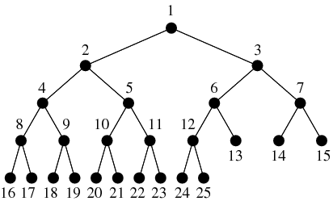
Don't Use Exceptions For Flow Control [3]
void binaryTreeSearch(TreeNode node, Object data)
throws ResultException{
if (node.data.equals(data))
throw new ResultException(node);
else {
search(node.leftChild, data);
search(node.rightChild, data);
}
}
The cute trick here is that the exception will break out of the recursion in one step no matter how deep it has got.
This violates the PrincipleOfLeastAstonishment.
This makes it harder for programmers to read.

Slide 19


Exceptions Benefits [1]
Keep cleanup code in a localized location, and to be sure that this cleanup code will execute
Keep code that deals with exceptional situations in one central place
Don’t have to be caught or detected at the place they occur
More descriptive than error codes
Provide repair model

Slide 20
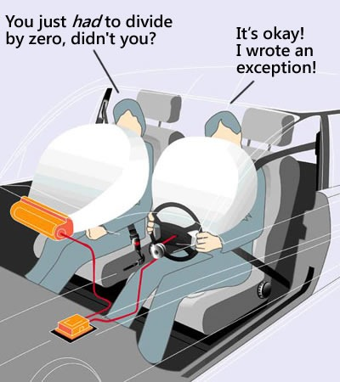
Exceptions Pros and Cons
Improve robustness
Make program more decent
Easier to find bug
Require mass of the code
May hide bug
Affect speed

Slide 21
The If-Then-Throw Pattern [8]
public class Match()
{
public Match(String id, String home, String visitors)
{
// If-Then-Throw implementation
if (String.IsNullOrWhitespace(id))
throw new ArgumentException("id");
if (String.IsNullOrWhitespace(home))
throw new ArgumentException("home");
if (String.IsNullOrWhitespace(visitors))
throw new ArgumentException("visitors");
...
}
...
}

Slide 22
Code Contracts
Under which conditions can the method be invoked?
Pre-conditions
Which conditions are verified after the method terminates?
Post-conditions
Which conditions do not change before and after the method execution?
Invariants
http://research.microsoft.com/en-us/projects/contracts/
https://msdn.microsoft.com/en-us/library/dd264808%28v=vs.110%29.aspx?f=255&MSPPError=-2147217396 (MS Tool)

Slide 23
Why Logging [5]
Logging is a critical technique for troubleshooting and maintaining software systems.
Good logging mechanisms can save long debugging sessions and dramatically increase the maintainability of applications.
Logging is a useful means to figure out if an application is actually doing what it is supposed to do.
It provides information without requiring knowledge of programming language, and does not require specialized tools.
http://logging.apache.org/log4cxx/index.html
http://log4cpp.sourceforge.net/
http://logging.apache.org/log4j/
http://logging.apache.org/log4net/

Slide 24


Slide 25
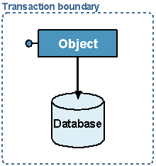
Error Handling with Transaction [6]
try
{
using(TransactionScope scope = new TransactionScope())
{
/* Perform transactional work here */
// No errors-commit transaction
scope.Complete();
}
}
catch(TransactionAbortedException e)
{
// handle abort condition
}
catch // Any other exception took place
{
Trace.WriteLine("Cannot complete transaction");
throw;
}

Slide 26
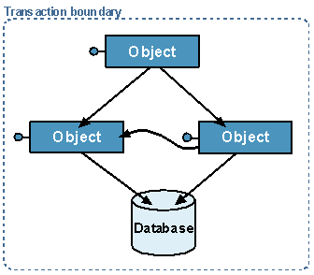
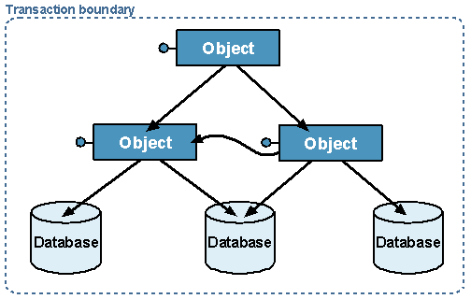
Transaction Boundary
Multiple objects / single resource transaction
Multiple objects accessing multiple resources
Lightweight Transaction Manager (LTM)
MSDTC (Microsoft Distributed Transaction Coordinator) manages distributed transactions.

Slide 27
Transaction Scope Options
The ambient transaction is the transaction that is present in the thread that the current application code is executing within.
A TransactionScope object has three options:
Join the ambient transaction.
Be a new scope root, that is, start a new transaction and have that transaction be the new ambient transaction inside its own scope.
Do not take part in a transaction at all.
using (TransactionScope scope = new
TransactionScope(TransactionScopeOption.Required))
//TransactionScopeOption.RequiresNew
//TransactionScopeOption.Suppress
{...}

Slide 28
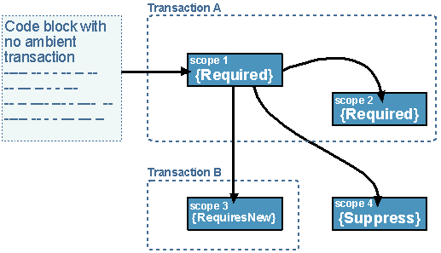
Transaction Flow Across Scopes
using(TransactionScope scope1 = new TransactionScope())
//Default is Required
{
using(TransactionScope scope2 = new
TransactionScope(TransactionScopeOption.Required))
{...}
using(TransactionScope scope3 = new
TransactionScope(TransactionScopeOption.RequiresNew))
{...}
using(TransactionScope scope4 = new
TransactionScope(TransactionScopeOption.Suppress))
{...}
...
}

Slide 29
Declarative Programming Model
using System.EnterpriseServices;
[Transaction]
public class MyComponent : ServicedComponent
{
[AutoComplete]
public void MyMethod()
{
/*Interact with other serviced components
and resource managers */
}
}
All the object has to do is inform .NET whether it should commit or abort the transaction.
In a method with the AutoComplete attribute, if no exception is thrown then the application will implicitly request a commit of the transaction.

Slide 30
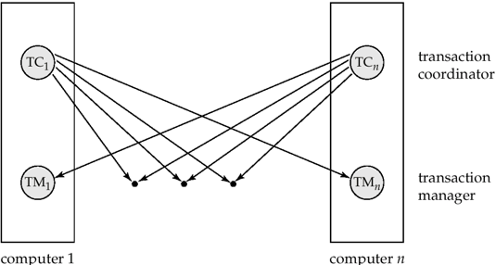
Distributed Transaction System Architecture
http://www.codeproject.com/Articles/690136/All-About-TransactionScope
Transaction Manager: Maintains a log and uses that log if recovery is needed. There are two types of transaction managers.
Local Transaction Manager: Coordinates transaction over a single resource only.
Global Transaction Manager: Coordinates transaction over multiple resources.
Transaction Coordinator: Starting the execution of transactions that originate at the site. Distributes sub-transactions at appropriate sites so that they can execute in those sites. Coordinates each transaction of each site. As a result the transaction is committed or rolled back to all sites.

Slide 31
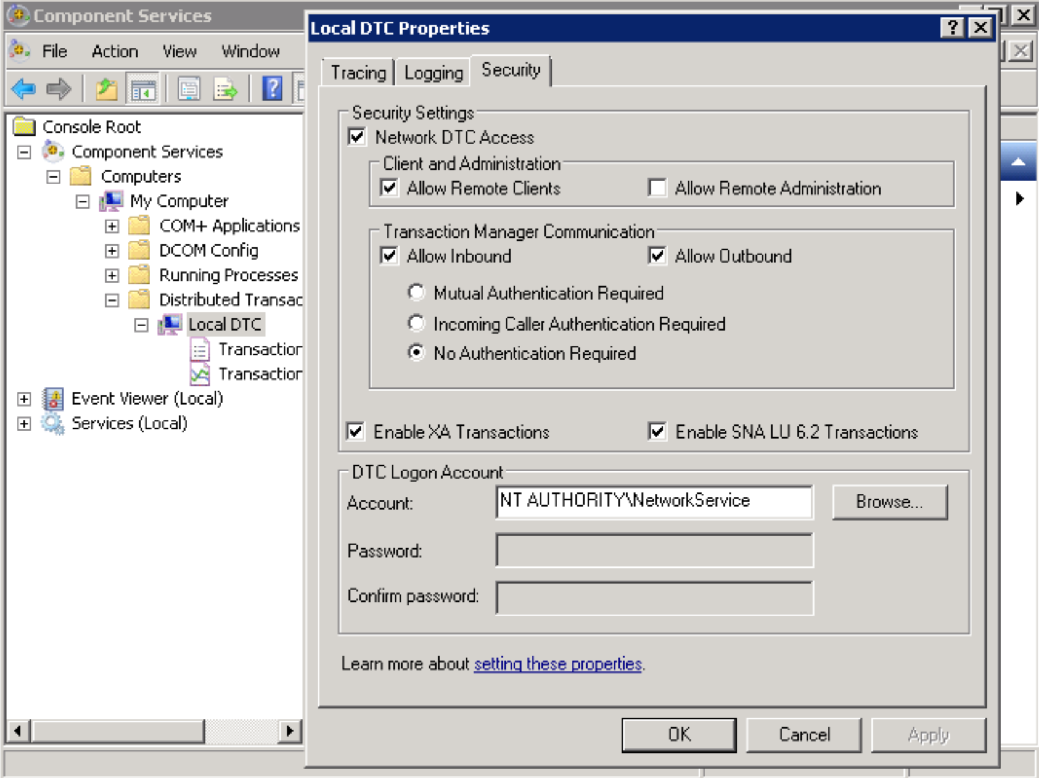
MSDTC Configuration
ControlPanel > AdministritiveTools > ComponentServices > DistributedTransactionCoordinator > LocalDTC > Right click > Properties > Security

Slide 32
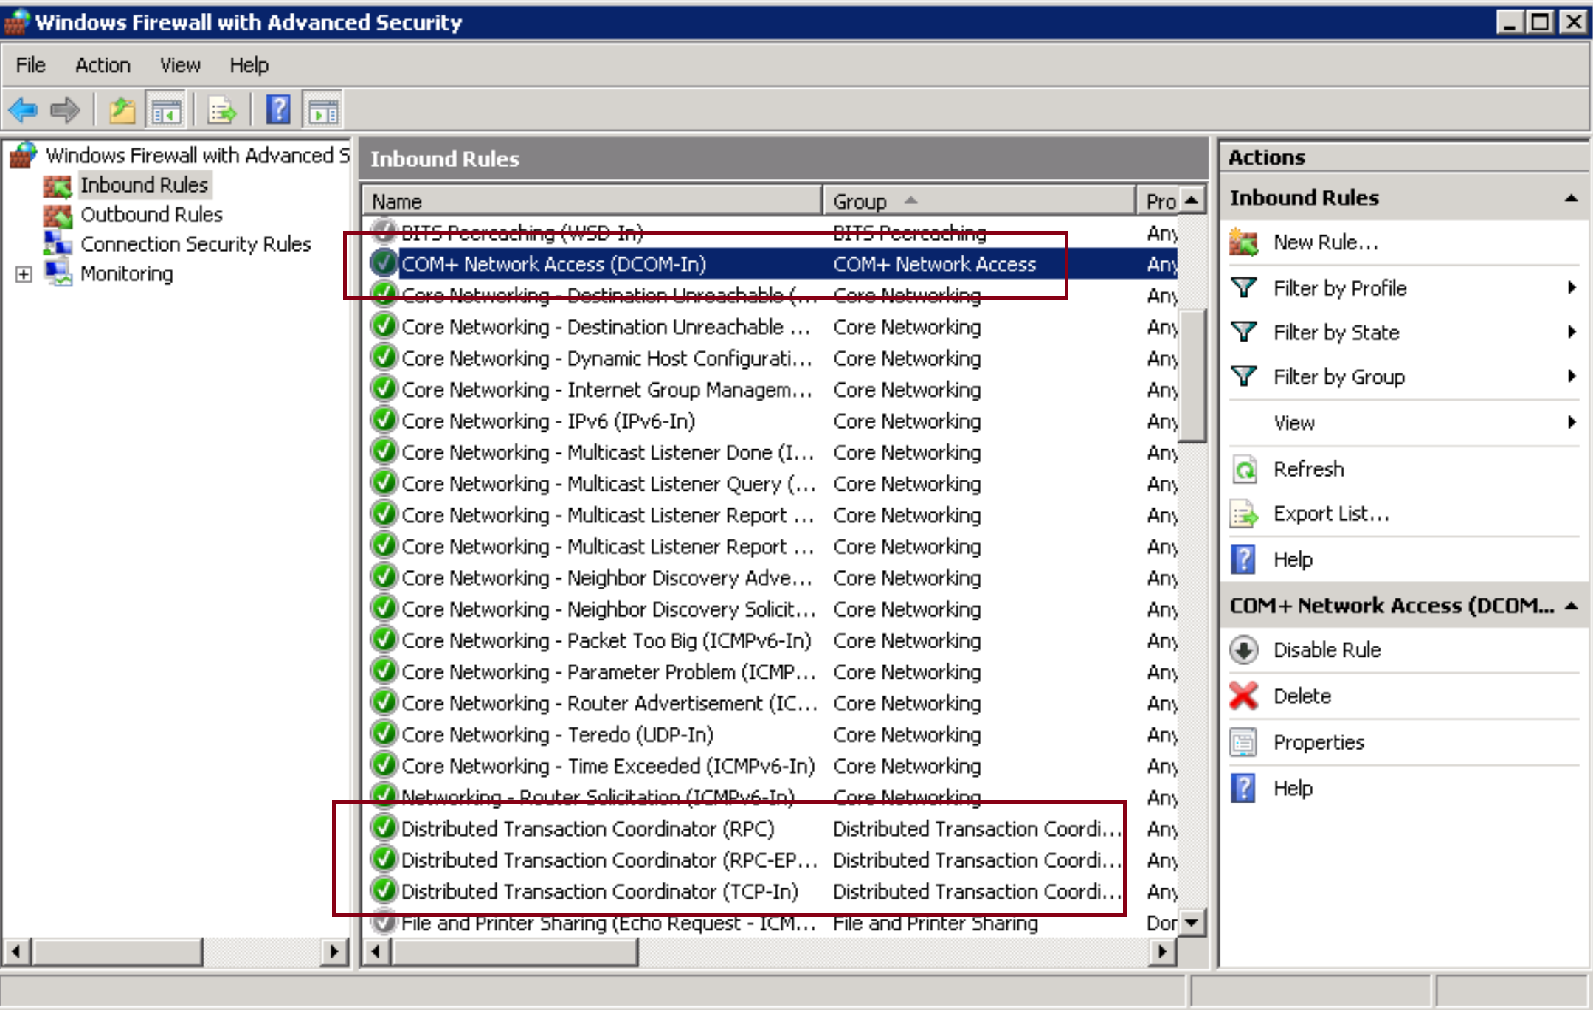
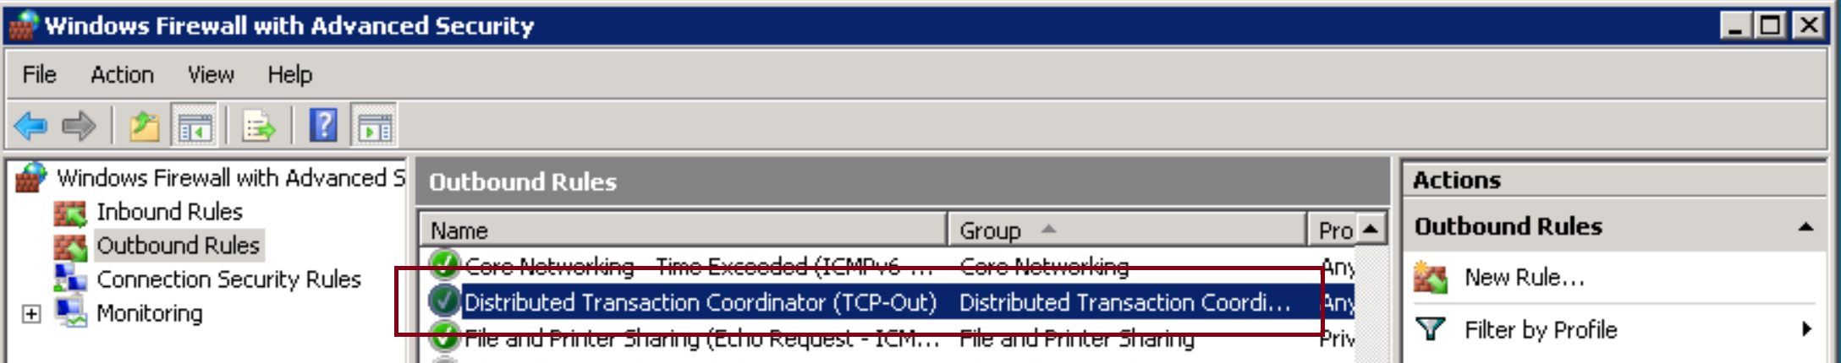
MSDTC Firewall

Slide 33
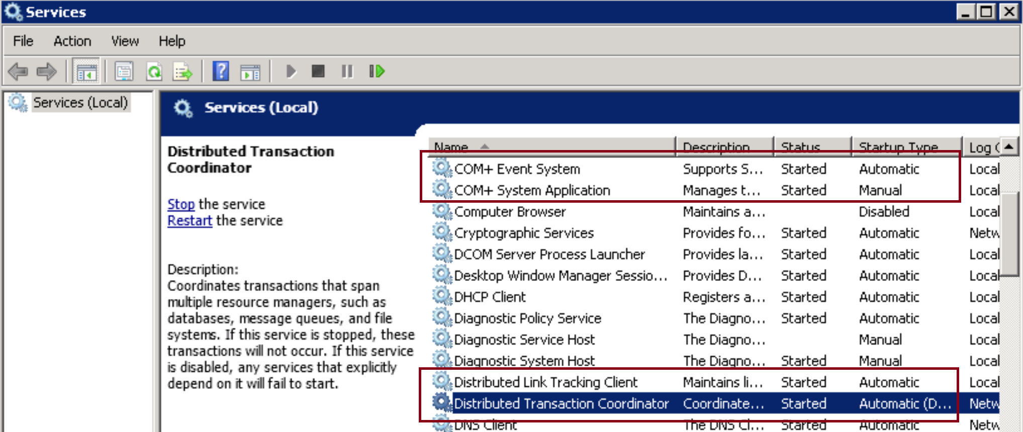
MSDTC Services

Slide 34
MSDTC And NetBIOS
On computer 1: ipconfig /all > Host Name 1
On computer 2: ping Host Name 1
On computer 2: ipconfig /all > Host Name 2
On computer 1: ping Host Name 2

Slide 35
Transaction Isolation Level

Slide 36
Data Recovery [7]
Transactions guarantee all-or-nothing atomicity in the sense that a failure in the middle of an ongoing transaction does not leave any traces and persistence in the sense that the effects of a committed (i.e., successfully completed) transaction will survive future failures.
Atomicity and persistence are usually implemented by logging data modifications on stable storage, typically, one or more dedicated disks.
During recovery after a failure log entries are sequentially read from the stable log file.
In a redo pass, all updates that are not reflected in database pages on the disk are redone by replaying log operations.
Then an undo pass considers all log entries that belong to incomplete transactions and removes their effects.

Slide 37
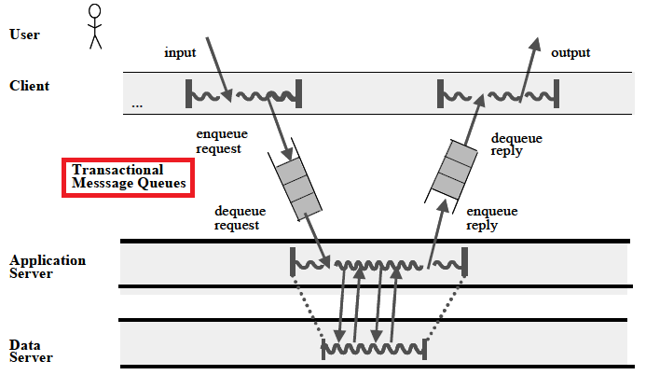
Application Recovery
Queued transactions, invented for OLTP (online transaction processing) and supported by most TP monitors (e.g., IBM MQ Series, BEA Tuxedo, Microsoft MTS) and associated web application servers (e.g., IBM WebSphere, BEA WebLogic, Microsoft IIS).

Slide 38

Thank You & See You Again

